Slide 1
CS4499/5599: Data Science and Applied Machine Learning
Class Lecture: February 22nd, 2023

Slide 2
Objectives
Last time:
Linear Regression
Creating regression models
Evaluating regression models
Today:
Regression Example in Colab
Introduction to Machine Learning

Slide 3
History of Machine Learning
Machine learning goes back all the way back to the 1950s
Shortly after the first “computers” were developed scientist began looking for ways to make programs more adaptable
While it is debated who first proposed the concept of machine learning it is generally accepted that IBM first proposed the idea in 1959

Slide 4
History of Machine Learning
Although there has been research in machine learning since the 1950s many factors limited the field
The thinking at the time is that machine learning would be part of an artificial intelligence system, that would mimic how humans think and process information
Although many in both fields still believe this is a function of machine learning, it is important to note that A.I and machine learning are separate (yet interconnected) areas of study

Slide 5
What is Artificial Intelligence?
The goal of A.I is to develop a system that behave like a human does
Usually an A.I systems mimics human behavior through some math or logic model that attempts to model human behavior
The primary goal of A.I is to simulate human reasoning in order to make decisions
Ideally, the system would be able to process information and data and “learn” how to behave

Slide 6
What is Machine Learning?
Where does machine learning fit in all this?
Machine learning is an application of A.I
We use machine learning models to learn, make decisions and ultimately adapt and perform better
The key difference however is that an A.I. system’s goal is to think like a human.
Machine learning systems are not bound like this, these systems goals is to develop the best system for a given application

Slide 7
What is Machine Learning?
A good example of this is an artificial neural network
Originally the ideal of the ANN was to mimic how the human brain behaves
However, in the last 10-15 years during the neural network “boom”, scientist have shifted the goal past mimicking human intelligence to perform task better
This has resulted in ANNs that can perform amazing things such as photo recognition, generative learning, etc.

Slide 8
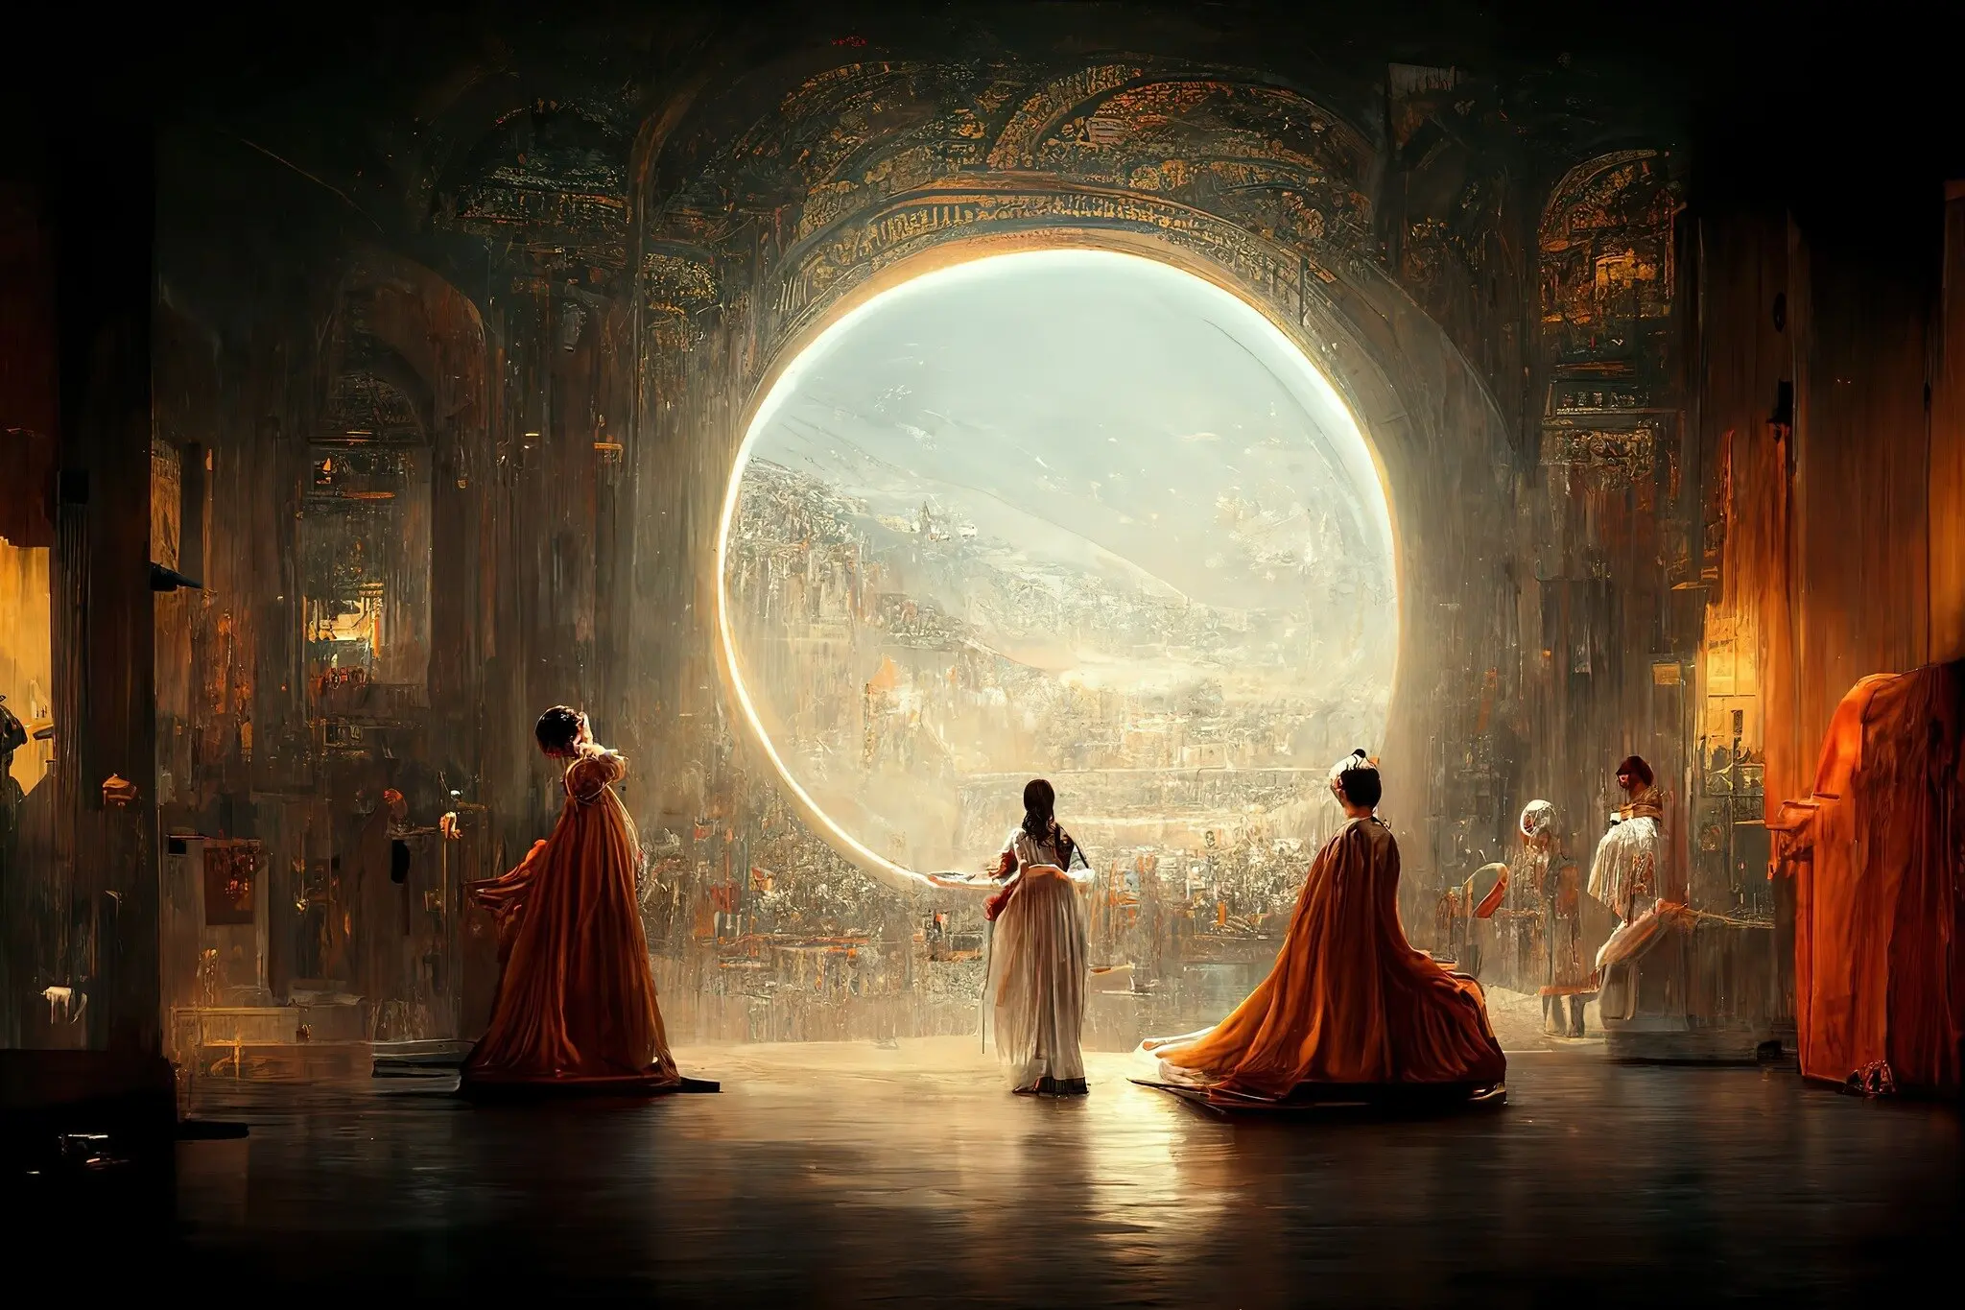
What is Machine Learning?
Created by Jason M. Allen using machine learning.

Slide 9
What is Machine Learning?
Before we continue, let’s go over some actual definitions of machine learning:
Machine Learning is the field of study that gives computers the ability to learn with our being explicitly programmed.
Arthur Samuel, 1959
A computer program is said to learn from experience E with respect to some task T and some performance measure P, if its performance, on T as measure by P improves with experience E.
Tom Mitchell, 1997

Slide 10
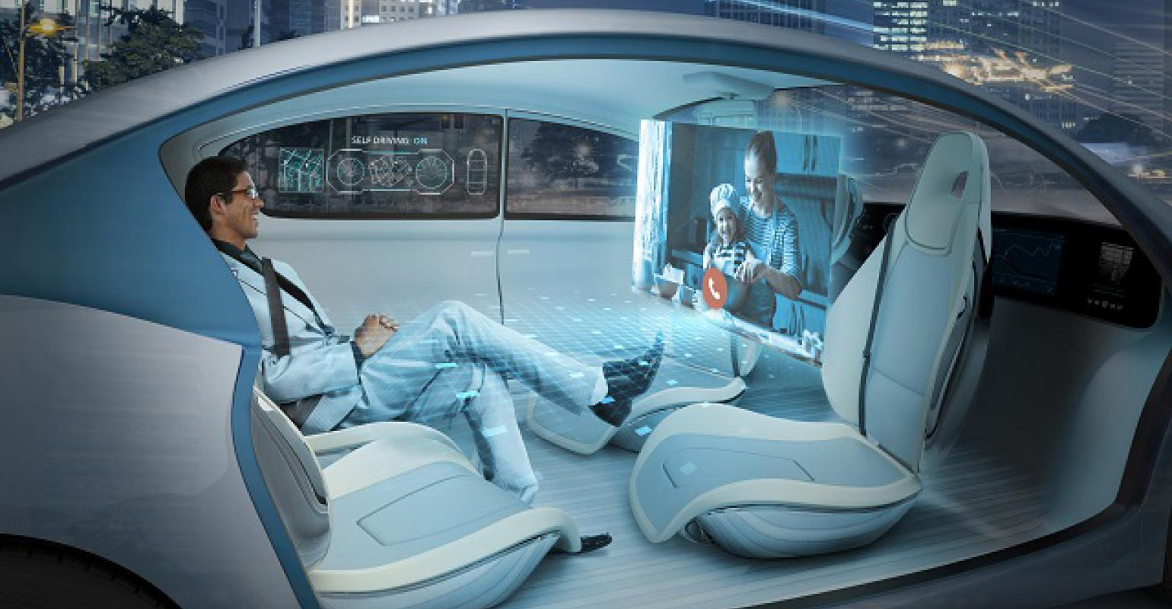
Applying Machine Learning
When thinking about applying machine learning our thoughts tend to go to something like this:

Slide 11
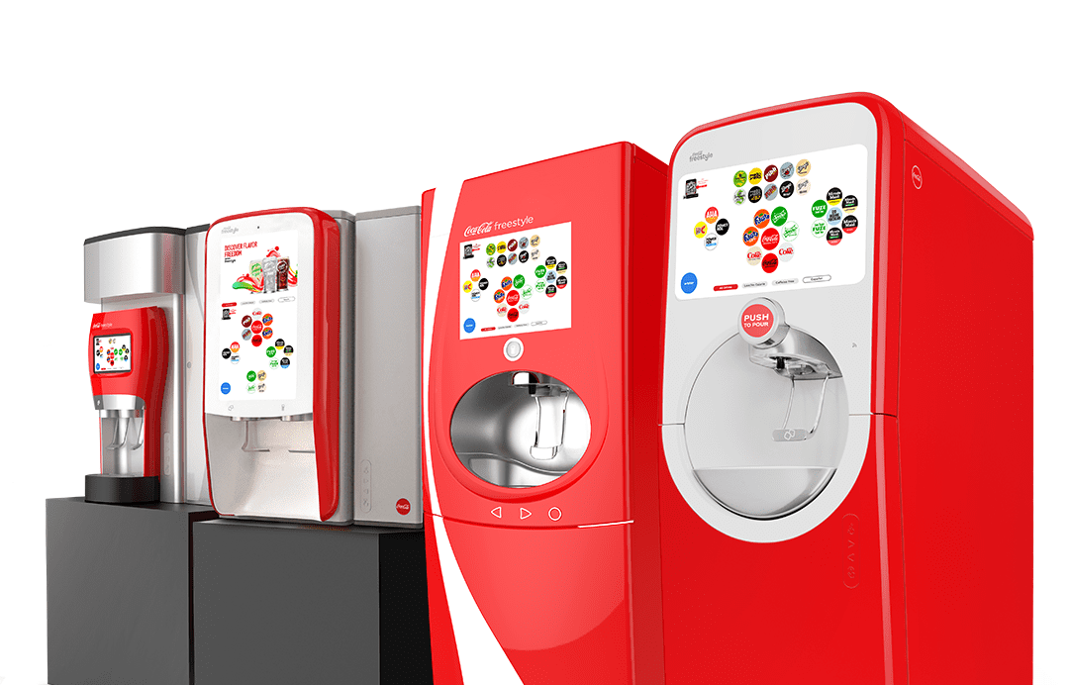

Applying Machine Learning
However, the application of machine learning today still looks like this:

Slide 12


Applying Machine Learning
Or:

Slide 13
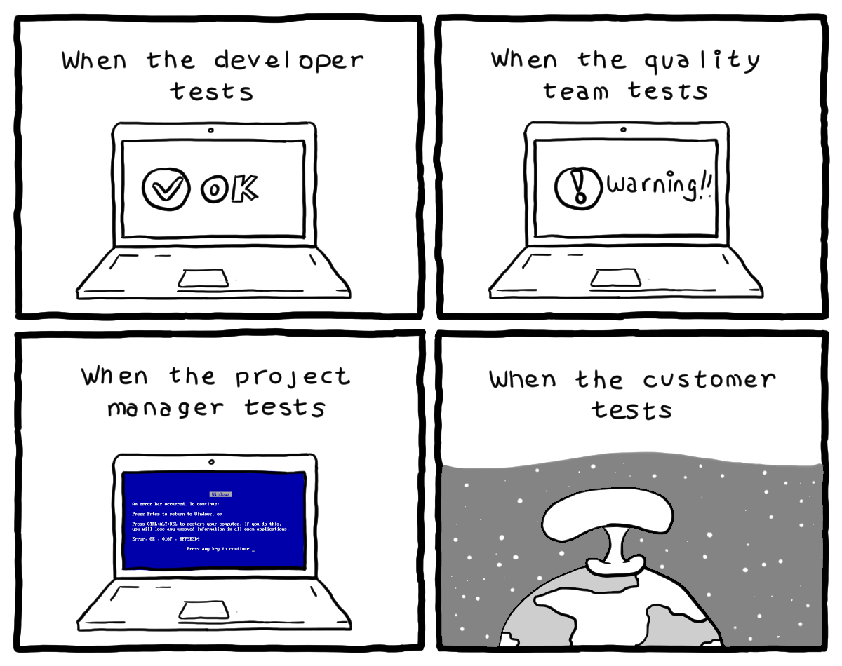
Applying Machine Learning
Source: turnoff.us

Slide 14
Why use Machine Learning?
Let’s look at a classic application of machine learning, the email spam detector
Suppose I gave you the job of developing and implementing an email spam detection system, what is the first thing you would want to do?
Likely, you would want to study the problem and develop some criteria

Slide 15
Why use Machine Learning?
The criteria would likely include a choice of keywords that would indicate spam.
Ex. “free”, “credit card”, “amazing”, among many others
Then you would implement the rules perhaps using an if, else-if statement. If your program encounter the word (key words or perhaps words), the program would flag the email(s) as spam.
However, there is a major limitation to this approach, any idea what it is?

Slide 16
Why use Machine Learning?
A machine learning model can learn patterns and words allowing for a simpler (and shorter) program
However, the most powerful advantage is the ability to adapt
Consider that the spammers realize which words a tipping off the spam detector
They may just start using new words or phrases to try and get around the detector
This would require us to re-write and adjust our detector every time the spammer changes strategy

Slide 17
Why use Machine Learning?
A machine learning model however can adapt as users flag emails as spam that contain new words.
For example, say our spammer notices that “4 U” has become a word filtered by our spam detectors and changes the phrase to “For U”
As emails are flagged as spam the machine learning model can adapt and learn the new phrases relatively quickly
In this case the programmer doesn’t have to adjust the program, as it adjust automatically!

Slide 18
Common Applications of Machine Learning
Analyzing images of products on the production line in order to classify them
Using medical images to detect small tumors in areas such as the brain
Classifying news articles (or now video) by category
Automatically flagging offensive content on forums or message boards
Summarizing long documents
Personal Data assistants such as Siri or Alexa

Slide 19
Common Applications of Machine Learning
Forecasting revenue, sales, etc. for a company based on current data
Translating voice to text (known as natural language processing)
Evaluate purchases to determine if a transaction is fraudulent
Performing market segmentation based on customer demographics
Building bots for video games
Recommender systems

Slide 20
Types of Machine Learning
Today there are several different types of machine learning models that can be easily trained
Machine learning can be broken down into a few broad areas:
Supervised Learning
Unsupervised Learning
Semi-supervised Learning
Reinforcement Learning

Slide 21
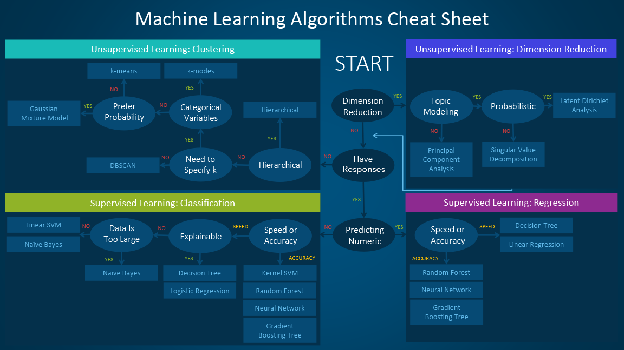
Types of Machine Learning

Slide 22
Supervised Learning
Supervised learning is likely the most common type of machine learning algorithm
These algorithms learn based on the outcome of the data used to train the model
For example, in our spam detector model, the email being flagged as spam would be an outcome
These outcomes are commonly referred to as targets, classes or labels
Models can be binary or multi-class

Slide 23
Unsupervised Learning
The next type of machine learning algorithms involve no outcome
These models are helpful when we don’t know a lot about our data
For example, an unsupervised learning model could be used to segment different groups of customers in ways we as human might not easily recognize
The biggest challenge with this type of model is evaluate its effectiveness
Common applications include anomaly detection and dimensionality reduction

Slide 24
Semi-supervised & Reinforcement Learning
These two types of machine learning algorithms are relatively new, but have exciting potential
Semi-supervised learning is designed to deal with data that is only partially labeled
This is extremally common in industry and has great value
Google and Facebook photo recognitions utilizes this type of algorithm
Typically, these involve some sort of hybrid algorithm

Slide 25
Semi-supervised & Reinforcement Learning
Reinforcement learning is very different from the other types of machine learning algorithms
These type of models make use of agents to observe and learn the environment
These systems make use of rewards and punishments to craft a policy
The policy is the set of rules the system follows and is updated continuously
These type of models are extremally novel in mainstream use

Slide 26
Next Time
Begin discussing the machine learning process
Remember Homework 5 is due on next Wednesday 03/01

